Slide 1




Weather Prediction And Analysis
Author
Jeanie Wu, Pooja Mahajan & Rasika Patil
Notes:
Jeanie

Slide 2

Project Description
With the pandemic subsiding slowly, people are excited about travel and outdoor activities. Our project focused analyzing historical hourly weather data to develop a weather prediction tool.
This tool predicts the weather based on user inputs and provides recommendations for planning outdoor activities according to the predicted weather.
For this pilot project, our team selected historical weather data between 2015-2018 for one city in Spain (Valencia) to build and test the tool.
As historical data was readily available, our team chose supervised machine learning to build the prediction tool
Data Source
https://www.kaggle.com/datasets/nicholasjhana/energy-consumption-generation-prices-and-weather?resource=download&select=weather_features.csv
Notes:
Jeanie

Slide 3







Tools and Technologies
Technologies
Languages
Tools
Algorithms
Logistic Regression
Random Forest
Support Vector Machine
Feature Selection
Label Encoder
Hyperparameter Tuning
Notes:
Jeanie
Pass to Rasika

Slide 4
Weather Prediction Tool development
Step 1
Data Exploration and Cleanup (ETL)
Step 2 Save data to Postgres
Step 3 Train and test data using supervised ML algorithms; select the best fit model
Step 5 Create web page that calls ML model for prediction and renders weather prediction.
Step 4 Create a flask app which calls ML model for prediction
Step 6
Create and host dashboard using Tableau and embed into the webpage
Notes:
Rasika

Slide 5
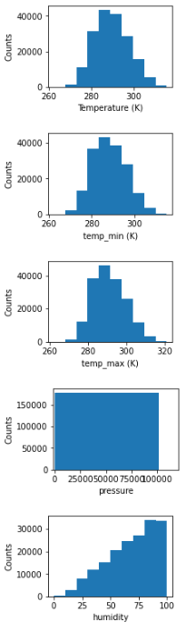
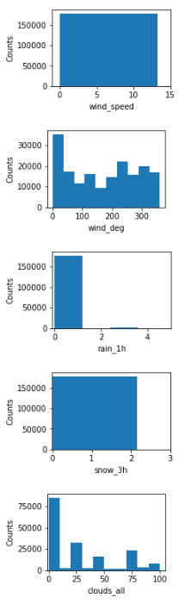
Data Exploration - ETL
The available dataset contained four years (2015 till 2018) of hourly weather data that used to describe the weather (shown in the figure):
Avg Temp
Min Temp
Max Temp
Pressure
Humidity
Wind speed
Wind degree
Rain 1h
Rain 3h
Cloud cover
We decided to keep the outliers in the data
Notes:
Rasika

Slide 6
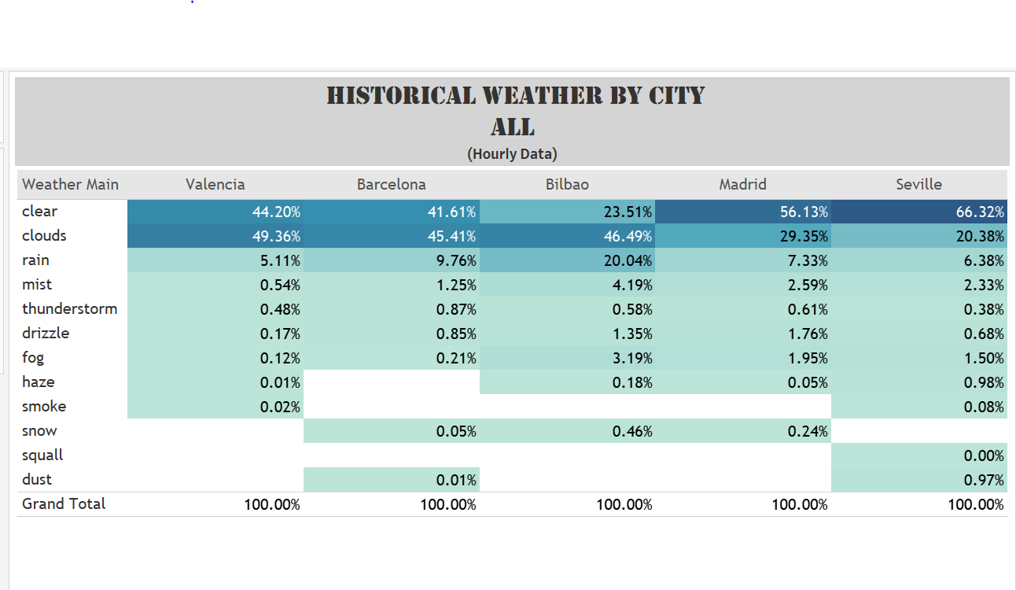
Data exploration - ETL Contd….
This data was imbalanced, meaning, 85 % of the data is either clear or cloudy for the City of Valencia.
Due to processing speed and memory size constraint only Valencia city data is used for prediction.
Valencia data contains 34k total rows
clouds 17346
clear 15535
rain 796
mist 190
thunderstorm 169
drizzle 58
fog 42
smoke 6
haze 3
Data Clean Up Steps:
Removed the data with null values.
Dropped columns not relevant to ML
development.
Saved the data to SQL – Postgres database.
Notes:
Rasika
Pass to Pooja

Slide 7
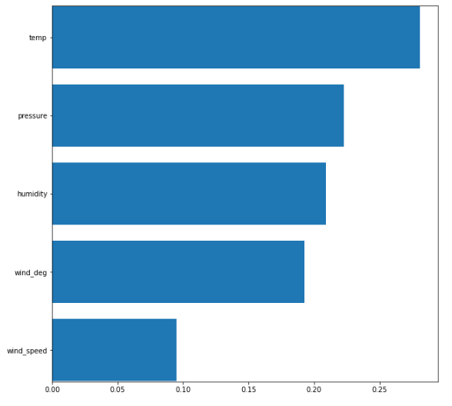
Supervised Machine learning steps
Retrieve data from Postgres
Independent Variables (X):
Data type: Numeric
Use filter-based Feature Selection method to choose relevant features
Used Standard Scaler to scale the input (X)
Dependent Variable (Y):
Data type: String
Used Label Encoder to encode categorical data to numeric values
ML Models:
Used Random Forest Classifier with and without feature selection
Used Logistic Regression with and without feature selection
Used Support Vector Machine (non-linear kernels)
Polynomial
Gaussian radial basis function (rbf)
Hyperparameter tuning
Notes:
Pooja

Slide 8
Model Test Scores
Model Name | Data Processing | Model Parameters | Training Score
Logistic Regression | 80/20 train test split |  | Training Score: 60.7% Testing Score: 61.1%
Logistic Regression w Feature Selection | 80/20 train test split # of features = 3 |  | Training Score: 56.6% Testing Score: 56.7%
Random Forest Classifier | 80/20 train test split | random_state=1, n_estimators=500 | Training Score: 98.7% Testing Score: 69.4%
Random Forest Classifier w Feature Selection | 80/20 train test split # of features = 3 | random_state=1, n_estimators=500 | Training Score: 90.2% Testing Score: 64.7%
Support Vector Machine | Radomized Search CV | kernel=‘rbf' Hyperparameter Tuning: C: (0, 100, 1), gamma: (0, 0.01, 0.0001) 50 fits | Accuracy: 65.36% F1: 64.12%
Support Vector Machine | Radomized Search CV | kernel='poly’ Hyperparameter Tuning: C: (0, 100, 1), degree: (0, 10, 1) 50 fits | Accuracy: 60.82% F1: 58.84%
Overfitted model
Best fitted model
Model selected: Random Forest Classifier w Feature Selection
Notes:
Pooja
Pass to Jeanie

Slide 9
Web page development & Data visualization
Data Rendering:
A html webpage calls a flask application which scales the input ( weather features ) and then sends the data to Model.
Model then predicts the weather which is rendered on html page.
Data Visualization :
Tableau is used for data insights and for historical weather trend analysis.
Tableau report is published and is embedded in html to render weather trends.
Notes:
Jeanie
Pass to Rasika

Slide 10
LIMITATIONS and Future Analysis
To avoid imbalanced data either drop the minority data (count < 1%) or use the SMOTE method to balance the data.
SMOTE is an algorithm that performs data augmentation by creating synthetic data points based on the original data points.
ANOVA technique to check the impact of the features by comparing the means of different samples
Weather parameters available in the dataset were in SI units, may need to convert data to locally used units
Using SVM with Hyperparameter tuning required high processing time (500 iterations)
Scaling the model to include more cities and using current weather data
We completed the ETL process for the energy consumption dataset but due to time constraint, we decided to drop it from the scope. Future analysis can include using historical weather and energy consumption data to predict energy pricing
Notes:
Pooja

Slide 11
